Slide 1

CS4225/CS5425 Big Data Systems for Data Science
Week 13 Test Revision
Ai Xin
School of Computing
National University of Singapore
aixin@comp.nus.edu.sg

Slide 2
Week 13 Test Instructions
Date: April 13, Thursday
Time:
Grp L2: 5pm-630pm (be seated at 445pm)
Grp L1: 630pm-8pm
TAs to mark attendance outside of auditorium 2 from 615-630pm
Students arrives after 630pm are NOT allowed to attend the test
Venue: UTOWN AUDITORIUM 2
Held in person; open book + notes, but no electronics usage
Seating plan is available at Canvas -> Files -> Week13_Test
Special arrangements have been sent to students by emails

Slide 3
Utown Auditorium 2 at 630pm
5-630pm session students will exit the venue through front doors (Door 1 and Door 2)
630–8pm session students will enter the venue through back doors (Door 3 and Door 4)
Please do arrive at 615pm for TA to mark your attendance
Students with name initial A-K go to the open space outside Door 3
Students with name initial L-Z go to the open space outside Door 4
Students arrives after 630pm are NOT allowed to attend the test

Slide 4
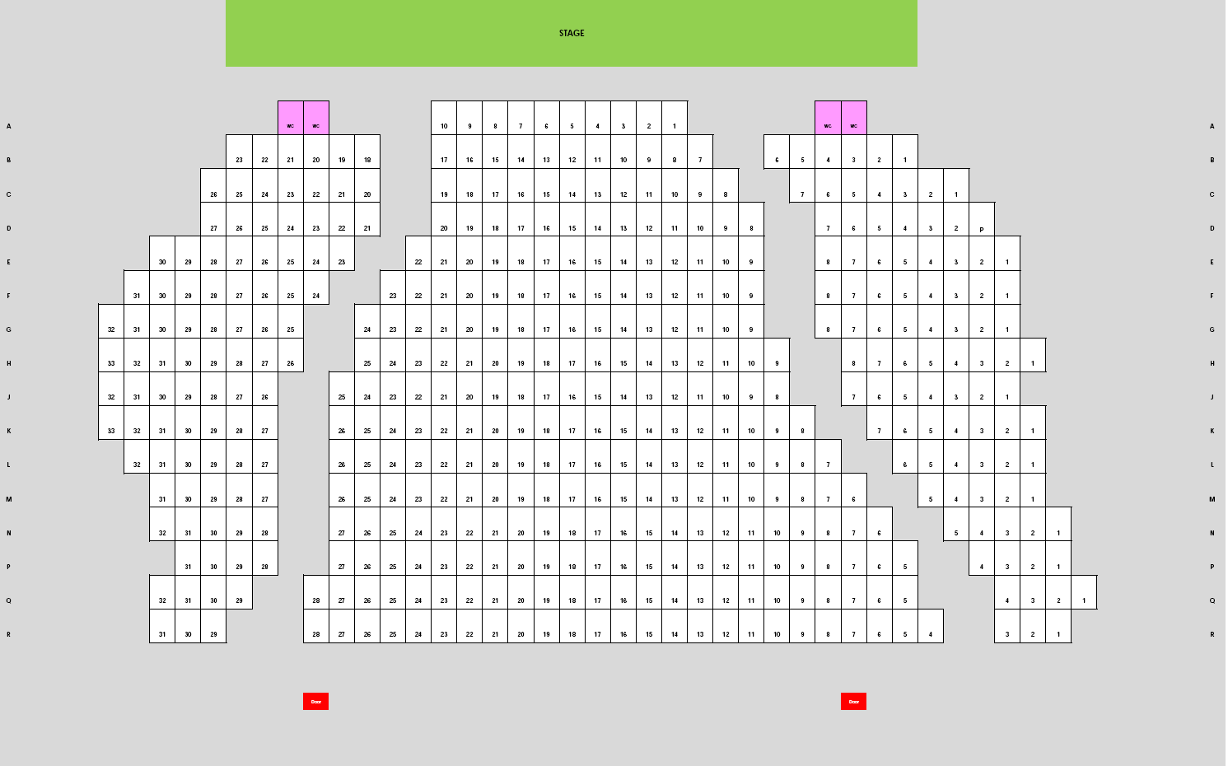
Utown Auditorium 2
Door 1
Door 2
Door 3
Door 4

Slide 5
Test
Focus is on understanding and application, not facts / memorization
Question structures (total 25 marks):
Ture / False question with a short explanation / justification
Application / Scenario Based Question
Give you a practical scenario and let you come out a solution / suggestion
Example questions
Integrative: Require you to combine knowledge from different weeks of content
“Application”: Require you to apply your knowledge of fundamental concepts to reasonably practical scenarios.
“Why not”: Example, Tommy proposed a solution A to solve problem B. Tell me what is the problem with solution A and how to overcome this problem

Slide 6
Scope of Test
Scope: the content in the lectures
Focus is on the content after recess week
We may ask you to compare the big data system learned after recess week with the big data system learned before recess week
Out of scope:
The content marked as “optional” or in the appendix
Additional information in the comment box
Some notes in the comment box is explaining / clarifying the content in the slides, which is not additional information.
In the following, I will
Have a revision on the key points that we learnt after recess week.

Slide 7
NoSQL
NoSQL
mainly refers to open source, distributed, non-relational database
Major Types of NoSQL Stores
Key-value, Document, Wide Column, Graph
Eventual Consistency
Duplication (i.e. denormalized view)
Partitioning
Table Partitioning
Horizontal / Range Partitioning
Hash Partitioning
Consistent Hashing
No one size fits all

Slide 8
Spark I
Introduction
In memory processing and easy to use
Driver and Executors
RDD
Distributed, Immutable, Lazy Transformations, Action to trigger the computation
Caching an RDD: when it is expensive to compute and needs to be re-used many times
DAGs
The lineage of an RDD, Within Stage (Narrow Transformation), Across Stage (Wide Transformation)
DataFrame: the recommended interface
filter, sort, join, groupby, and etc.
Datasets: type-safe during compile time

Slide 9
Spark II
Spark SQL and Catalyst Optimizer
Unifies Spark components and permit various languages
Tell Spark what to do and then Spark will generate an optimized plan
Machine Learning using Spark Mllib
Pipeline, Transformer, Estimator
Training the Model using train data
Cache the train data in memory to speed up the iterative training
Evaluation the Model using test data
Spark Structured Streaming
Micro-Batch approach, Incremental Execution
Five Steps to define a streaming query
Stateless Transformation: filter(), map(), etc.
Stateful Transformation / Aggregation
Not Based on Time: groupBy().count()
Based on Time:
event time, processing time, Tumbling Windows, Overlapping / Sliding Windows
watermark: handling late data

Slide 10
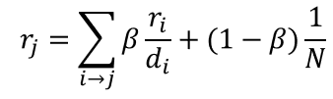
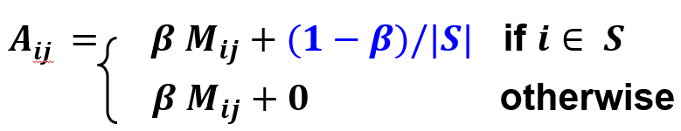
Graph
Introduction
Nodes and Edges, Focus on the relationship between different nodes
Simplified PageRank
Flow formulation
Random Walker formulation
PageRank with Teleports
Topic Specific PageRank
PageRank Implementation
Pregel Model, Think like a Vertex, superstep, compute()
Partition (Edge Cut) and assign to Workers

Slide 11
Evolution of Data Architectures
Relational Database
strong transactional ACID guarantees
Data Warehouses
a central relational repository, ACID guarantees
Data Lake
A distributed storage solution, runs on commodity hardware and easily scales out horizontally
Decouples the distributed storage and computing
Mostly cannot provide ACID guarantees, lack of schema enforcement
Lakehouses: data lake + data warehouse
Flexible, low cost, scale + ACID transactions
Delta Lake solution: DeltaLog (a single source of truth).

